Slide 1
Jon Maxwell
Project report
BCM390, “Media, war and peace,” autumn session, 2013
University of Wollongong
The project report had two components. For details of the assignment see http://www.bmartin.cc/classes/BCM390_13outline.pdf
1. An information pack, starting on the next slide.
2. A fictional dialogue about carrying out the project, available as a separate file.
This document can be accessed via http://www.bmartin.cc/classes/mwp_tops.html.

Slide 2
GENOCIDE
The Rwandan Genocide
This is a timed presentation.
Slides progress automatically.
Student no: 3880564 Tutor: Brian Martin

Slide 3
This presentation contains numerous, very explicit, images which some may find disturbing.
Viewer discretion is strongly advised.

Slide 4
What is genocide?

Slide 5
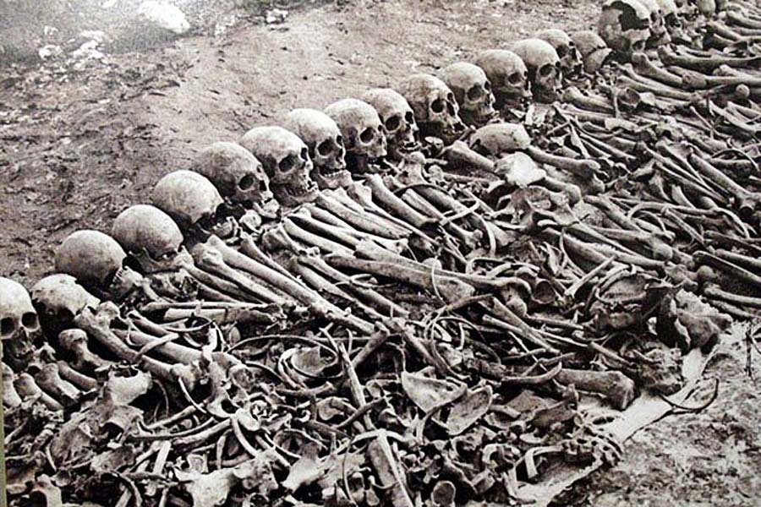
Notes:
http://genocidewatch.net/genocide-2/genocide-and-politicide/

Slide 6
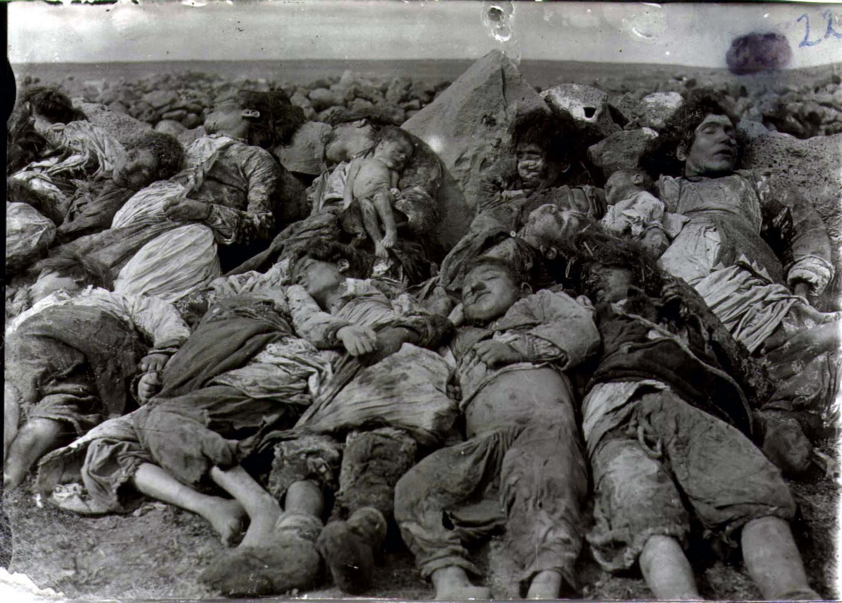
Notes:
http://diatribe-column.blogspot.com.au/2013/03/genocide-gyrations.html

Slide 7
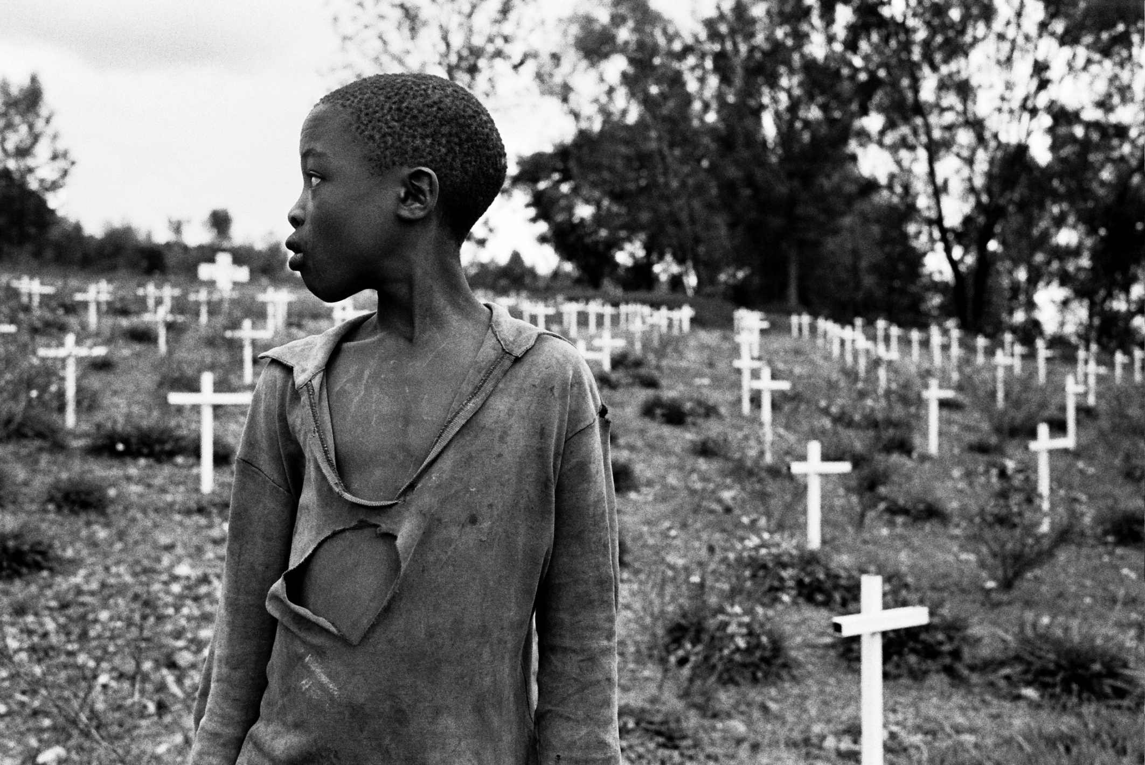
Notes:
http://artsonline.monash.edu.au/acjc/ats2057-genocide/

Slide 8
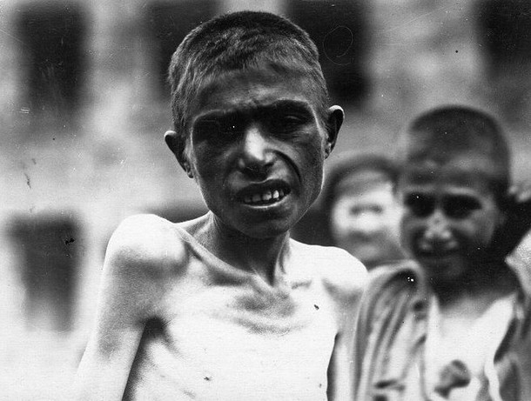
Notes:
http://islamizationwatch.blogspot.com.au/2010/03/turkey-angry-at-us-armenian-genocide.html

Slide 9
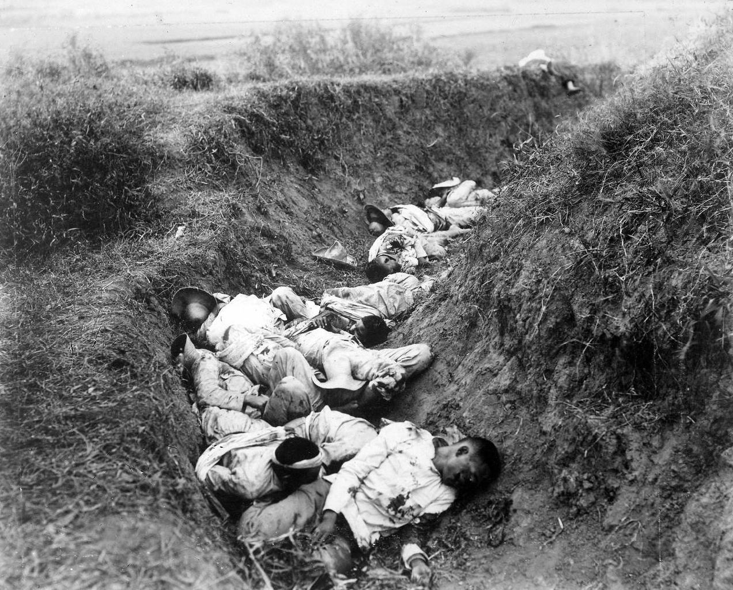
Notes:
http://bradleygray96.wix.com/genocide

Slide 10
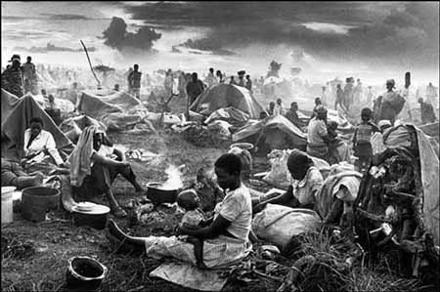
Notes:
http://www.muslimpopulation.com/africa/Rwanda/Islam%20Blooms%20in%20Rwanda%20Genocide's%20Wake.htm

Slide 11
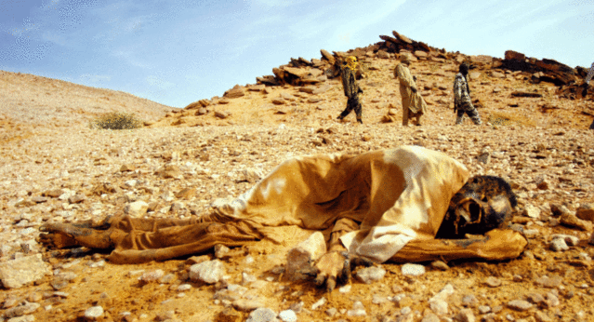
Notes:
http://www.genocidepreventionmonth.org/genocide-in-darfur.html

Slide 12
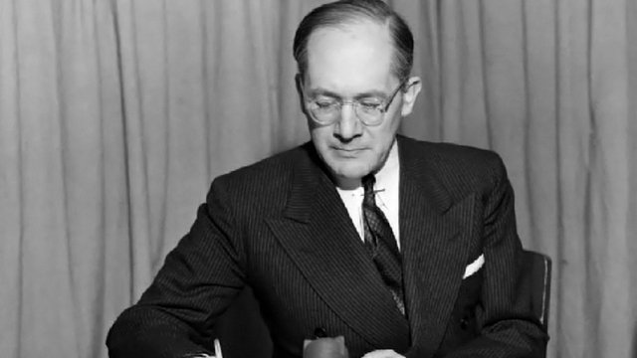
The term ‘genocide’ was first coined by Raphael Lemkin in 1944 to describe the Nazi extermination of the Jews.[1]
There is no agreed definition of ‘genocide’.[1]
Notes:
[1] Rubinstein, W.D. (2004) ‘Genocide and Historical Debate’, History Today, vol.54, no.4, p.36-38
[IMAGE] ‘The Tragedy of Raphael Lemkin on Vimeo’, accessed 11/06/2013, http://vimeo.com/13501953

Slide 13
The 1948 United Nations Convention on the Prevention and Punishment of Genocide defines it as:[2]
Any of the following acts committed with intent to destroy, in whole or in part, a national, ethnical, racial or religious group, as such:
Killing members of the group;
Causing serious bodily or mental harm to members of the group;
Deliberately inflicting on the group conditions of life calculated to bring about its physical destruction in whole or in part;
Imposing measures intended to prevent births within the group;
Forcibly transferring children of the group to another group.
Notes:
[2] UN (2000) ‘Convention on the Prevention and Punishment of the Crime of Genocide, New York, 9 December 1948’, accessed 05/06/2013, http://www.un.org/

Slide 14
Simply put:
Genocide is the deliberate and intentional killing of all or most of a specific group of people simply based on their religion, their nationality, their ethnicity, or their race. [1] [3]
Notes:
[1] Rubinstein, W.D. (2004) ‘Genocide and Historical Debate’, History Today, vol.54, no.4, p.36-38
[3] Campbell, C. (2009) ‘Genocide as Social Control’, Sociological Theory, vol.27, no.2, p.150-168

Slide 15
rwanda

Slide 16
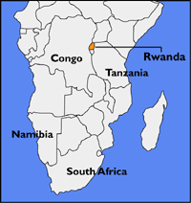
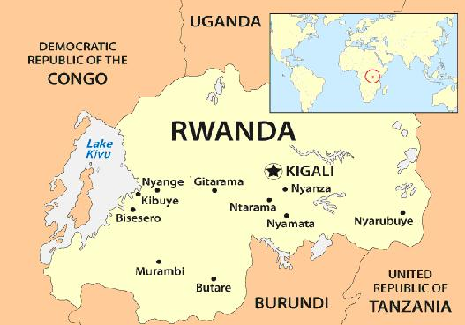
Notes:
[LEFT] MAPS: Rwanda, accessed 11/06/2013, http://fs.huntingdon.edu/jlewis/syl/ircomp/MapsRwanda.htm
[RIGHT] Map of Rwanda, accessed 11/06/2013, http://writepass.co.uk/journal/2012/12/tourism-in-rwanda-is-rapidly-increasing-since-the-genocide-that-took-place-in-1994/map-of-rwanda/

Slide 17
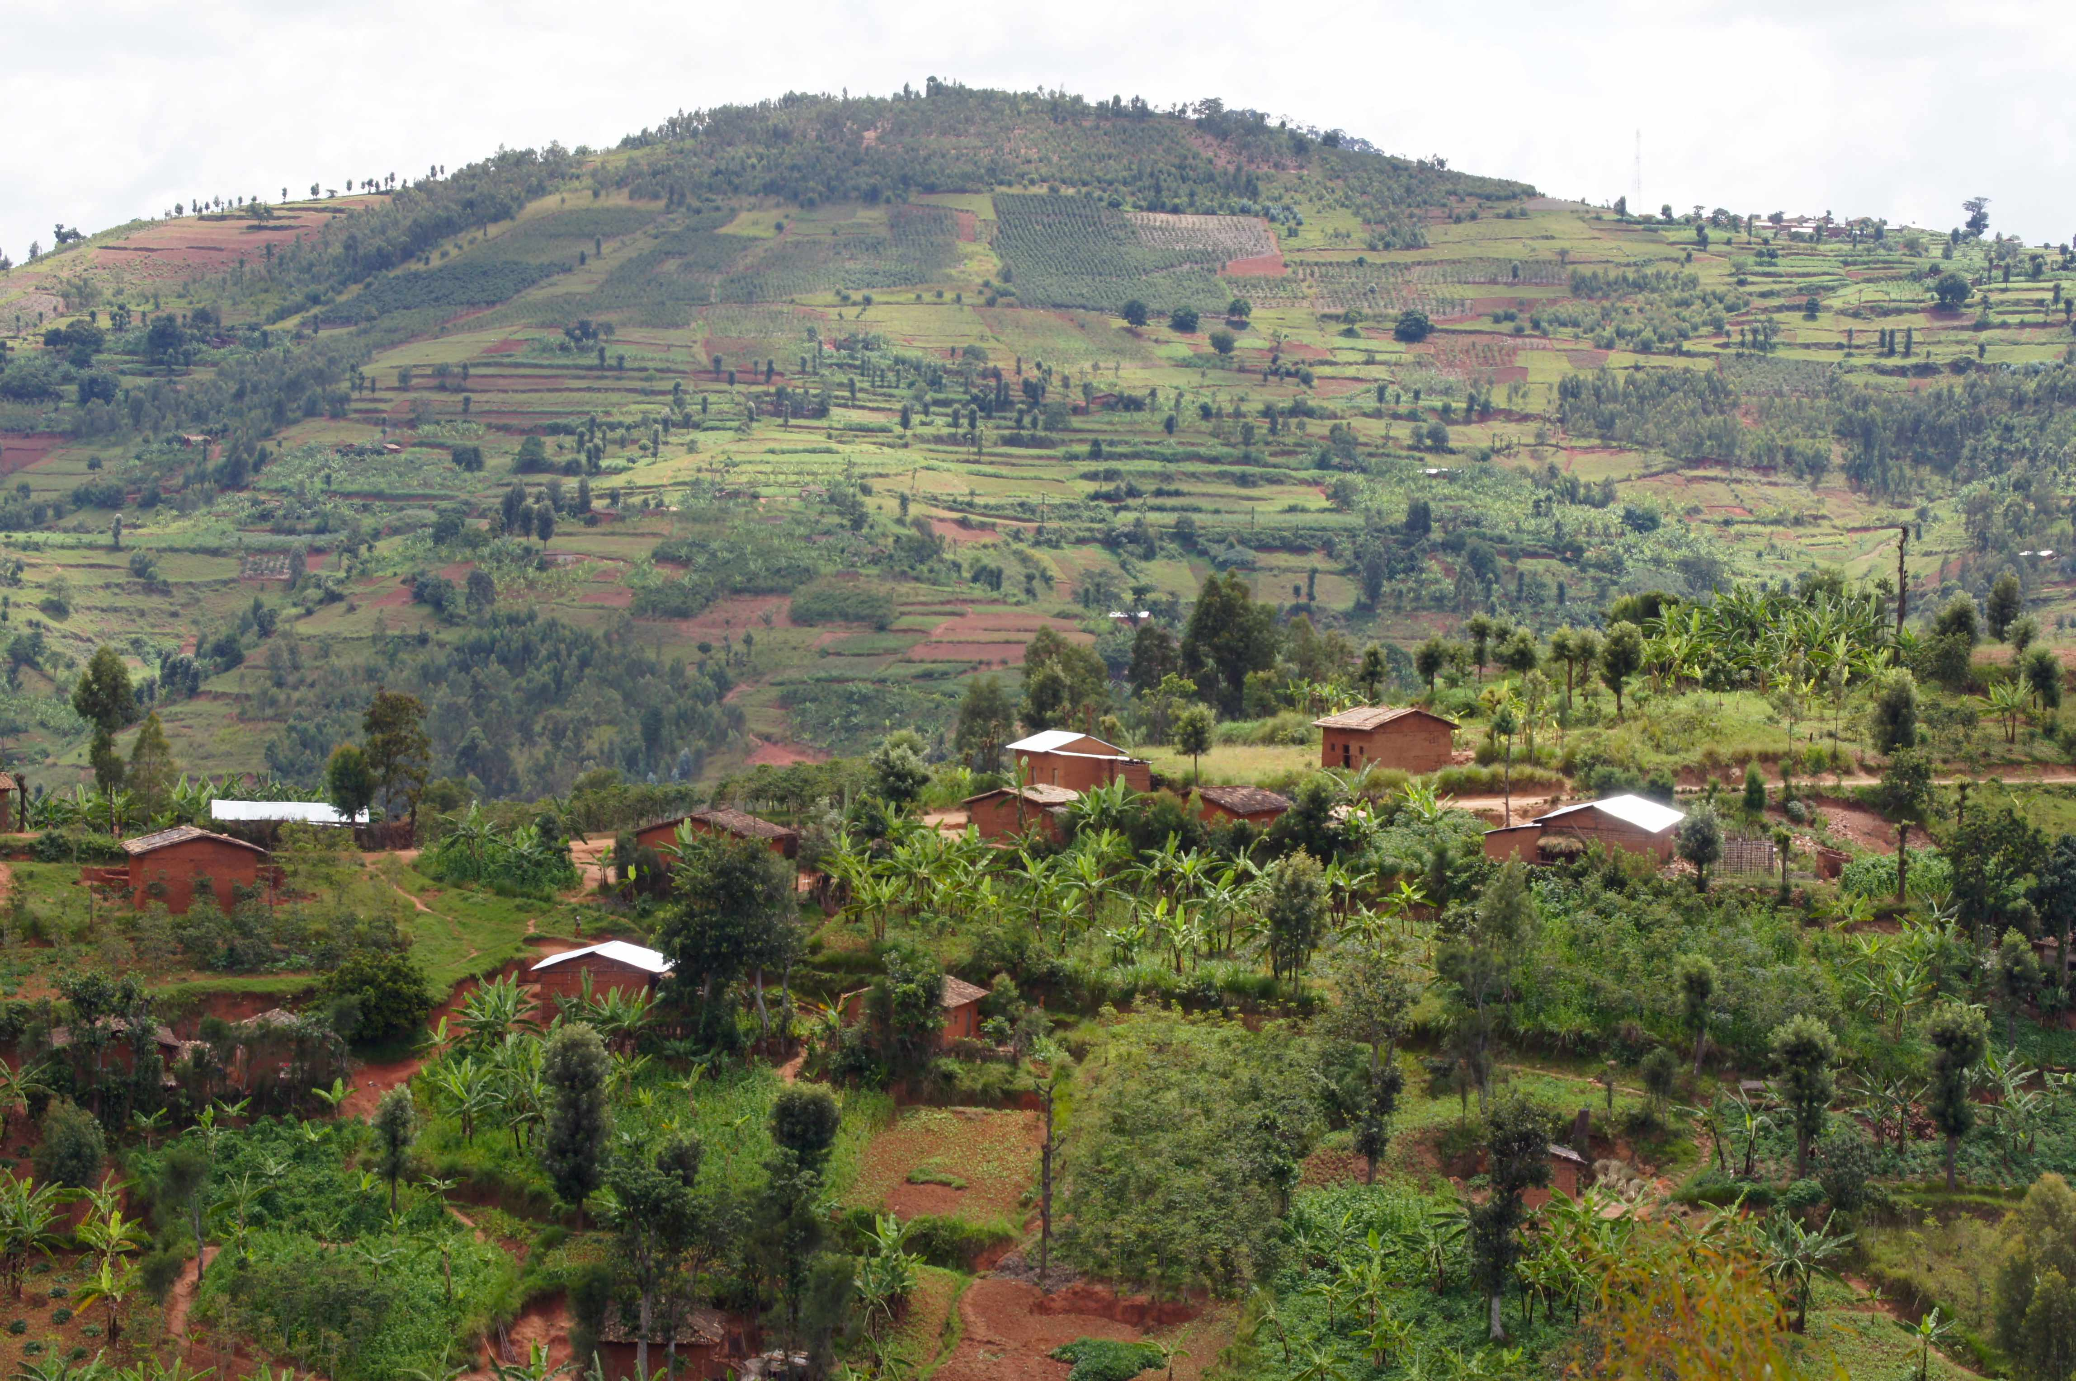
Notes:
http://nordicapproach.wordpress.com/2012/05/09/rwandaburundi-2012/

Slide 18
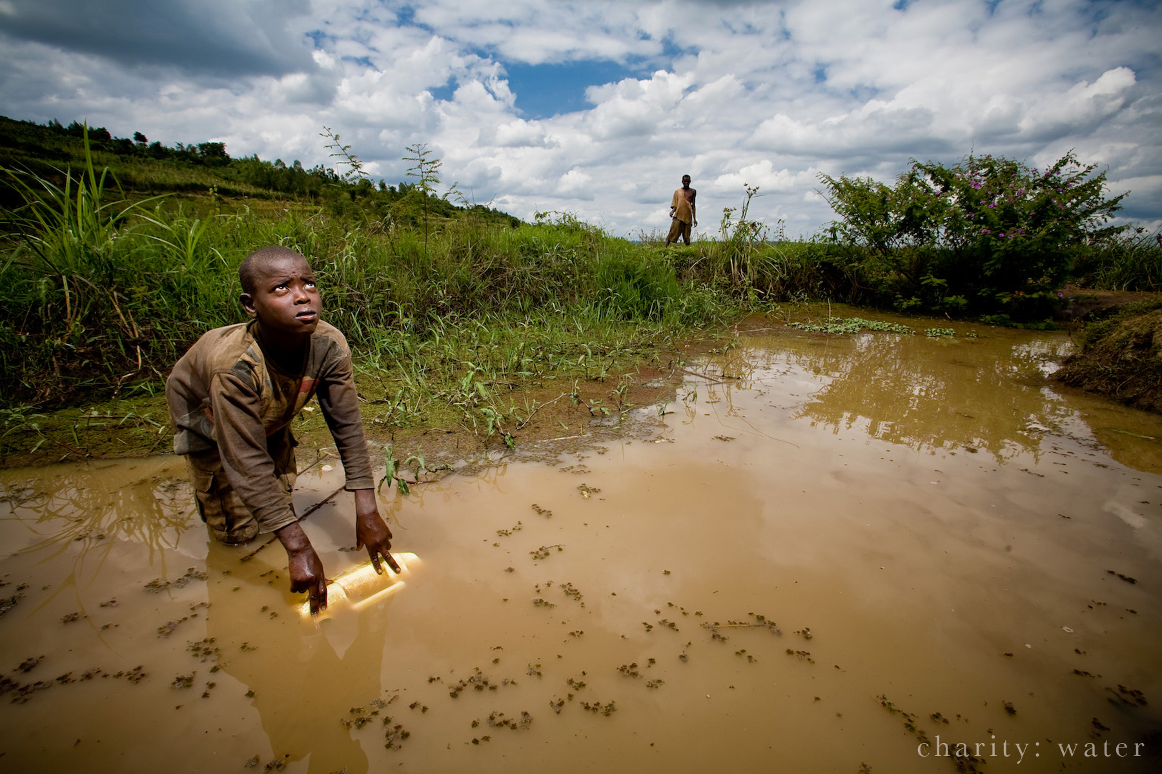
Notes:
http://spazzinsf.wordpress.com/tag/rwanda/

Slide 19
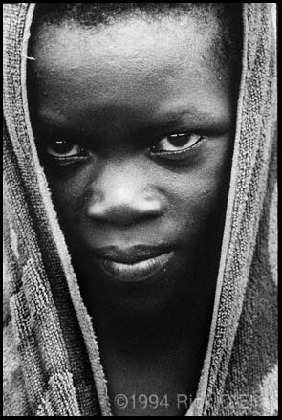
Notes:
http://www.photoworkshopuganda.com/

Slide 20
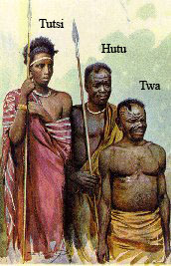
The two main ethnic groups in Rwanda are the Hutus (about 85% of population) and the Tutsis (about 15%) [4] [5]
“Rwanda’s 1994 genocide was retaliation by the states’ Hutu regime to a violent challenge from the [Rwandan Patriotic Front] who invaded from Uganda in 1990 and fought for over three years to seize effective control of Rwanda” [6]
Notes:
[4] CIA (2013) ‘Rwanda’, The World Factbook, accessed 06/06/2013, https://www.cia.gov/library/publications
[5] De Waal, A. And Omaar, R. (1995) ‘The Genocide in Rwanda and the International Response’, Current History, vol.94, no.591, p.156-161
[6] Kuperman, A.J. (2003) ‘How the Media Missed Rwandan Genocide’, accessed 06/06/2013, http://www.hawaii.edu/powerkills/COMM.7.8.03.HTM
[IMAGE] ‘Medias influence on Rwandan Genocide’ , accessed 11/06/2013, http://mediasinfluenceontherwandangenocide.blogspot.com.au/2010/12/hutus-and-tutsis-and-belgium.html

Slide 21
“The genocide unleashed by Rwanda’s Hutu extremists government on April 6, 1994, was the bloodiest 100 days of the second half of the twentieth century” [5]
Notes:
[5] De Waal, A. And Omaar, R. (1995) ‘The Genocide in Rwanda and the International Response’, Current History, vol.94, no.591, p.156-161

Slide 22
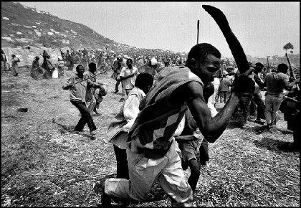
Notes:
http://www.missioni-africane.org/688__1a_domenica_di_avvento_-_29_novembre_2009

Slide 23
Over 100 days, the Hutus massacred approximately 800, 000 Tutsis. Though some argue the death toll was closer to 1 million [3]
The Rwandan media, utilized by Hutu extremists, was influential in the genocide, disseminating Hutu propaganda, inciting racial hatred and exposing locations of Tutsi peoples. [5]
Notes:
[3] Campbell, C. (2009) ‘Genocide as Social Control’, Sociological Theory, vol.27, no.2, p.150-168
[5] De Waal, A. And Omaar, R. (1995) ‘The Genocide in Rwanda and the International Response’, Current History, vol.94, no.591, p.156-161

Slide 24
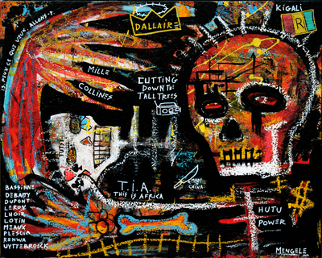
Notes:
http://www.popscreen.com/p/MTA3MTA0ODQx/Outsider-folk-art-Rwanda-Tutsi-Hutu-Christian-Mengele-eBay

Slide 25
HOW
WHY

Slide 26
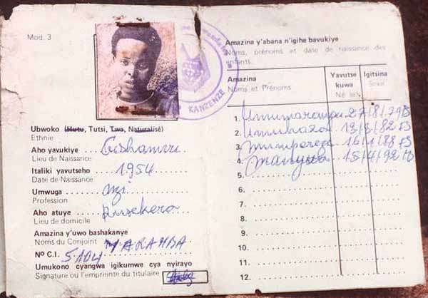
“Ethnic tension in Rwanda is nothing new” [7]
In 1916, Belgian colonists arrived in Rwanda. They considered the Tutsis to be superior to the Hutus, and produced identity cards to classify people according to their ethnicity. [8]
In 1959, resentment among the Hutus culminated in a series of riots. More than 20, 000 Tutsis were killed. [3] [7]
In 1962, Rwanda gained independence from Belgium. The Hutus gained power and began discriminating against the Tutsis. [3] [7]
Many Tutsis fled Rwanda to neighbouring Uganda [3]
Notes:
[3] Campbell, C. (2009) ‘Genocide as Social Control’, Sociological Theory, vol.27, no.2, p.150-168
[7] BBC (2011) ‘Rwanda: How the genocide happened’, accessed 05/06/2013, http://www.bbc.co.uk/news/
[8] Diamond, J. (2006) ‘Collapse: how societies choose to fail or succeed’, Penguin Books, New York, p.318
[IMAGE] Identity Card, accessed 11/06/2013, http://www.preventgenocide.org/edu/pastgenocides/rwanda/indangamuntu.htm

Slide 27
In 1987, the Rwandan Patriotic Front (RPF) was created. [3] [7] [9]
In 1990, the RPF invaded Rwanda from Uganda in an attempt to defeat the Hutu government. [3] [6]
In April, 1994, the assassination of Rwandan President Habyarimana led the Hutus to conduct systematic mass murder of Tutsis. [10]
On July 18, 1994, the genocide officially ended.
Notes:
[3] Campbell, C. (2009) ‘Genocide as Social Control’, Sociological Theory, vol.27, no.2, p.150-168
[6] Kuperman, A.J. (2003) ‘How the Media Missed Rwandan Genocide’, accessed 06/06/2013, http://www.hawaii.edu/powerkills/COMM.7.8.03.HTM
[7] BBC (2011) ‘Rwanda: How the genocide happened’, accessed 05/06/2013, http://www.bbc.co.uk/news/
[9] Republic of Rwanda (n.d.) ‘The Rwandese Patriotic Front’, accessed 05/06/2013, www.gov.rw
[10] Caplan, G. (2007) ‘Rwanda: Walking the Road to Genocide’ in Thompson, A. (2007) The Media and the Rwanda Genocide, Pluto Press, London, p.20-39
[IMAGE] Rwandan Patriotic Front, accessed 11/06/2013, http://en.wikipedia.org/wiki/Rwandan_Patriotic_Front

Slide 28
Theories of Genocide

Slide 29
Genocide as
Social Control
- Bradley Campbell
Genocide is normally a form of social control, a response to behaviour seen as deviant. Like other forms of violence, it is usually moralistic rather than predatory. [11]
The perpetrators express moral grievances against the targeted ethnic group. For example, the Hutus considered the Tutsis to be clannish, to hold the majority of places in secondary and higher education, and to have a foothold in all aspects of Rwandan society – such as the economy, the church, and political parties. [12]
Notes:
[11] Cooney, M. and Phillips, S. (2002) ‘Typologizing Violence: A Blackian Perspective’, International Journal of Sociology and Social Policy, vol.22, no.7, p.75-108 in Campbell, C. (2009) ‘Genocide as Social Control’, Sociologist Theory, vol.27, no.2, pp150-168
[12] Des Forges, A. (2007) ‘Call to Genocide: Radio in Rwanda 1994’ in Thompson, A. (2007) The Media and the Rwanda Genocide, Pluto Press, London, p.20-39

Slide 30
Genocide as
Social Control
- Bradley Campbell
In cases like this, genocide is seen as a means of handling grievances, real or perceived, against an ethnic group.
As social control, genocide belongs to the same sects of social life as law, gossip, terrorism, and warfare. All are aspects of society which are used to control and manipulate. [3]
Notes:
[3] Campbell, C. (2009) ‘Genocide as Social Control’, Sociological Theory, vol.27, no.2, p.150-168

Slide 31
Genocide as
transgression
- Dan Stone
The act of genocide creates ‘ecstatic communities’, that is, communities of people who experience an increased sense of belonging to their own group because they have transgressed together. [13]
Similarly, ‘ecstatic communities’ are formed through exclusion, typically in the form of racial, ethnic, or religious, hatred. This perpetuates the notion that, for the community to survive, the ‘other’ must be eliminated. [13]
Notes:
[13] Stone, D. (2004) ‘Genocide as Transgression’, European Journal of Social Theory, vol.7, no.45, p.45-60

Slide 32
Genocide as
transgression
- Dan Stone
Through genocide, individuals are given licence to indulge in the transgression of social norms and laws. The individual is ‘sustained and transformed by powers that are beyond him’ So much so, that many would be shocked by what they had done upon reflection. [13]
Notes:
[13] Stone, D. (2004) ‘Genocide as Transgression’, European Journal of Social Theory, vol.7, no.45, p.45-60

Slide 33
The Media

Slide 34
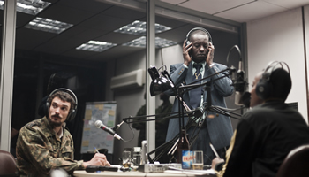
Notes:
http://www.afronline.org/?p=23731

Slide 35
Radio
News media played a crucial role in the genocide. [14]
Most Rwandans could not read or write, so radio was the main way which the government could deliver messages to the public. The radio also disseminated propaganda for the president’s party. [12]
In March 1992, Radio Rwanda directly promoted the killing of Tutsi. A warning that Hutu would be attacked by Tutsi was broadcast, it was used to convince Hutu that they should protect themselves by attacking first[12].As a result, local Hutu civilians and sympathetic militia attacked and killed hundreds of Tutsi. [15]
Notes:
[12] Des Forges, A. (2007) ‘Call to Genocide: Radio in Rwanda 1994’ in Thompson, A. (2007) The Media and the Rwanda Genocide, Pluto Press, London, p.20-39
[14] James, E. (2008) ‘Media, genocide and international response: another look at Rwanda’, Small Wars & Insurgencies, vol.19, no.1, p.89-115
[15] International Commission (1993) ‘International Commission of Investigation on Human Right Violations in Rwanda since October 1, 1990’, Final report. Africa Watch, International Federation of Human Rights Leagues, Interafrican Union for Human and Peoples’ Rights, and the International Center for Human Rights and Democratic Development, New York and Paris, March. in Des Forges, A. (2007) ‘Call to Genocide: Radio in Rwanda 1994’ in Thompson, A. (2007) The Media and the Rwanda Genocide, Pluto Press, London, p.20-39
[IMAGE] Radio Rwanda, accessed 11/06/2013, http://arts1091.unsw.wikispaces.net/Rwanda+2012

Slide 36
Radio
... After Radio Rwanda shut down.
Radio Television Libre des Milles Collines (RTLM) was a Rwandan radio station which, according to United Nations (UN) General, Romeo Daillaire, incited its listeners to kill. [14]
After president Habyarimana’s assassination, RTLM called for all Hutu to ‘rise up as a single man’ to defend their country in a war that ‘would exterminate the Tutsi from the globe... make them disappear once and for all’. [16]
Notes:
[14] James, E. (2008) ‘Media, genocide and international response: another look at Rwanda’, Small Wars & Insurgencies, vol.19, no.1, p.89-115
[16] Chrétien, J.P., Dupaquier, J.F. and Kabanda, M. (1995) ‘Rwanda: les médias du génocide’, Karthala, Paris, France. p.205 in Des Forges, A. (2007) ‘Call to Genocide: Radio in Rwanda 1994’ in Thompson, A. (2007) The Media and the Rwanda Genocide, Pluto Press, London, p.20-39

Slide 37
Radio
“All day long RTLM had been reporting the murders of his moderate allies and their families. The station encouraged its listeners to kill Tutsis and called for the death of all moderate Hutus, calling them traitors. The statements were accompanied by taped music from popular singers, violence-provoking songs with lyrics such as ‘I hate Hutus, I hate Hutus, I hate Hutus who think that Tutsis are not snakes” [14]
- General Romeo Daillare, commander of the Rwandan peacekeeping mission
Notes:
[14] James, E. (2008) ‘Media, genocide and international response: another look at Rwanda’, Small Wars & Insurgencies, vol.19, no.1, p.89-115

Slide 38
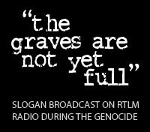
Notes:
http://nanojv.wordpress.com/2012/07/28/rtlm-radio-television-libre-mille-collines/

Slide 39
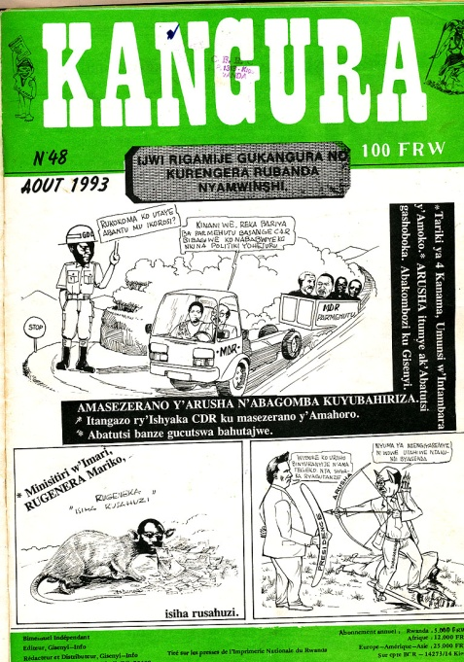
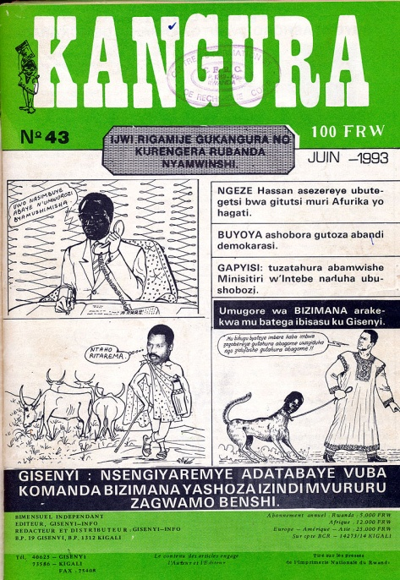
PRINT
Out of the 42 newspapers founded in 1991, 11 were linked to the Hutu regime and aggression towards Tutsi. [14]
One radical, anti-Tutsi paper was the Kangura.
“The malice, the evil are just as we knew them in the history of our country.” – March 1993 article [14]
In December 1990, Kangura published the ‘Ten Commandments’ for Hutus. The aim of which was to unite Hutu against Tutsi. [14]
Notes:
[14] James, E. (2008) ‘Media, genocide and international response: another look at Rwanda’, Small Wars & Insurgencies, vol.19, no.1, p.89-115
[LEFT IMAGE} Kangura no.48, accessed 11/06/2013, http://www.genocidearchiverwanda.org.rw/index.php/Category:Kangura
[RIGHT IMAGE] Kangura no.43, accessed 11/02013, http://www.genocidearchiverwanda.org.rw/index.php/Category:Kangura

Slide 40
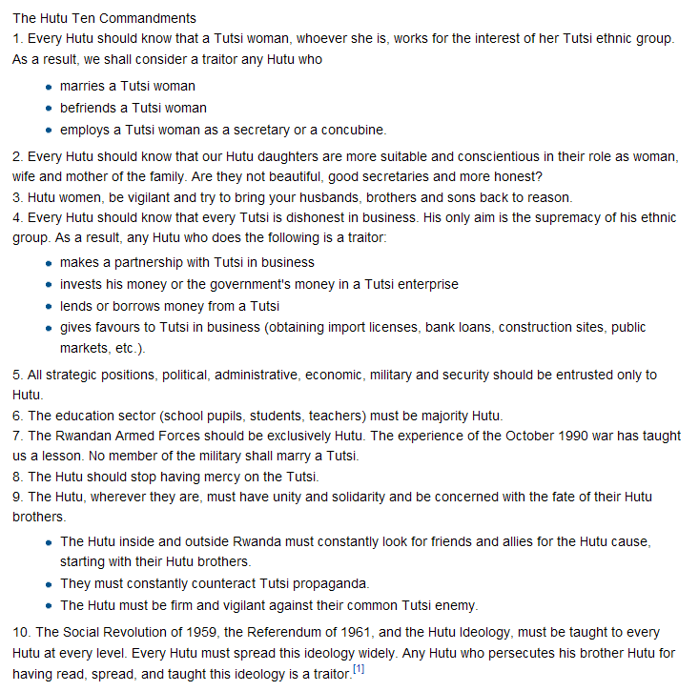
Notes:
http://yhwh1972.blogspot.com.au/2010_08_24_archive.html

Slide 41
The Rwandan media constantly circulated anti-Tutsi propaganda, portraying the Tutsi as deviants who had wronged the Hutu and need to be punished. Radio and print media expressed numerous grievances against Tutsis, successfully distancing them from the Hutu population and creating the right environment for retributive action. [3]
Tutsi were alienated and discriminated against as the ‘other’, as deviants that must be eliminated from Rwandan society. This characterisation of them by the Rwandan media shaped the Hutus’ views of their position and incited them to indulge in the transgression of social norms and laws. [3]
Notes:
[3] Campbell, C. (2009) ‘Genocide as Social Control’, Sociological Theory, vol.27, no.2, p.150-168

Slide 42
International Media Coverage

Slide 43
“The world didn’t seem to be paying attention to Rwanda, or realizing the dangers” [17]
International media reported that violence was waning in the lead up to the genocide, when the opposite was true. [6]
On April 11, four days after the genocide started, The New York Times reported that fighting had “diminished in intensity”. [6]
Notes:
[6] Kuperman, A.J. (2003) ‘How the Media Missed Rwandan Genocide’, accessed 06/06/2013, http://www.hawaii.edu/powerkills/COMM.7.8.03.HTM
[17] Doyle, M. (2007) ‘Reporting the Genocide’, in Thompson, A. (2007) The Media and the Rwanda Genocide, Pluto Press, London, p.20-39

Slide 44
The decline in reports of violence was because most foreigners had left Rwanda, including journalists. This effectively halted the Western media coverage of Rwanda. [6]
Western media had difficulty providing accurate reports because of their diminished presence, and the Hutu governments desire to manipulate facts in order to suppress international awareness of the genocide. [6]
This led to international media referring to the events in Rwanda as a ‘civil war’, instead of ‘genocide’. [18]
It wasn’t until five days after the genocide began that the French paper, Liberation, reported it as ‘genocide’. [18]
Notes:
[6] Kuperman, A.J. (2003) ‘How the Media Missed Rwandan Genocide’, accessed 06/06/2013, http://www.hawaii.edu/powerkills/COMM.7.8.03.HTM
[18] Stanton, G.H. (2004) ‘Could the Rwandan Genocide have been prevented?’, Journal of Genocide Research, vol.6, no.2, p.211-222

Slide 45
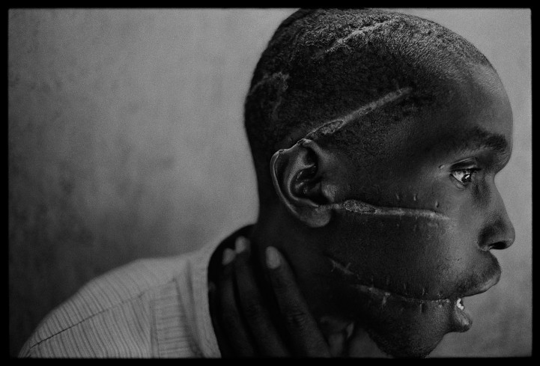
The media is supposed to provide fair, accurate, unbiased reporting.
It is an essential resource that the people of the world rely on.
But when events like the Rwandan genocide go largely unreported,
the integrity of our international media must come under question.
Notes:
http://advokatdyavola.wordpress.com/2012/06/16/on-the-rwandan-genocide-part-two-a-single-death-is-a-tragedy-a-million-deaths-is-a-statistic/

Slide 46
But when events like the Rwandan genocide go largely unreported,
the integrity of our international media must come under question.

Slide 47
REFERENCES
BBC (2011) ‘Rwanda: How the genocide happened’, accessed 05/06/2013, http://www.bbc.co.uk/news/
Campbell, C. (2009) ‘Genocide as Social Control’, Sociological Theory, vol.27, no.2, p.150-168
Caplan, G. (2007) ‘Rwanda: Walking the Road to Genocide’ in Thompson, A. (2007) The Media and the Rwanda Genocide, Pluto Press, London, p.20-39
Chrétien, J.P., Dupaquier, J.F. and Kabanda, M. (1995) ‘Rwanda: les médias du génocide’, Karthala, Paris, France. p.205 in Des Forges, A. (2007) ‘Call to Genocide: Radio in Rwanda 1994’ in Thompson, A. (2007) The Media and the Rwanda Genocide, Pluto Press, London, p.20-39
Cooney, M. and Phillips, S. (2002) ‘Typologizing Violence: A Blackian Perspective’, International Journal of Sociology and Social Policy, vol.22, no.7, p.75-108 in Campbell, C. (2009) ‘Genocide as Social Control’, Sociologist Theory, vol.27, no.2, pp150-168
CIA (2013) ‘Rwanda’, The World Factbook, accessed 06/06/2013, https://www.cia.gov/library/publications
De Waal, A. And Omaar, R. (1995) ‘The Genocide in Rwanda and the International Response’, Current History, vol.94, no.591, p.156-161
Des Forges, A. (2007) ‘Call to Genocide: Radio in Rwanda 1994’ in Thompson, A. (2007) The Media and the Rwanda Genocide, Pluto Press, London, p.20-39
Doyle, M. (2007) ‘Reporting the Genocide’, in Thompson, A. (2007) The Media and the Rwanda Genocide, Pluto Press, London, p.20-39
Diamond, J. (2006) ‘Collapse: how societies choose to fail or succeed’, Penguin Books, New York, p.318

Slide 48
References
International Commission (1993) ‘International Commission of Investigation on Human Right Violations in Rwanda since October 1, 1990’, Final report. Africa Watch, International Federation of Human Rights Leagues, Interafrican Union for Human and Peoples’ Rights, and the International Center for Human Rights and Democratic Development, New York and Paris, March. in Des Forges, A. (2007) ‘Call to Genocide: Radio in Rwanda 1994’ in Thompson, A. (2007) The Media and the Rwanda Genocide, Pluto Press, London, p.20-39
James, E. (2008) ‘Media, genocide and international response: another look at Rwanda’, Small Wars & Insurgencies, vol.19, no.1, p.89-115
Kuperman, A.J. (2003) ‘How the Media Missed Rwandan Genocide’, accessed 06/06/2013, http://www.hawaii.edu/powerkills/COMM.7.8.03.HTM
Republic of Rwanda (n.d.) ‘The Rwandese Patriotic Front’, accessed 05/06/2013, www.gov.rw
Rubinstein, W.D. (2004) ‘Genocide and Historical Debate’, History Today, vol.54, no.4, p.36-38
Stanton, G.H. (2004) ‘Could the Rwandan Genocide have been prevented?’, Journal of Genocide Research, vol.6, no.2, p.211-222
Stone, D. (2004) ‘Genocide as Transgression’, European Journal of Social Theory, vol.7, no.45, p.45-60
UN (2000) ‘Convention on the Prevention and Punishment of the Crime of Genocide, New York, 9 December 1948’, accessed 05/06/2013, http://www.un.org/
US Holocaust Museum (n.d.) ‘Coining a word and championing a cause: The story of Raphael Lemkin’, Holocaust Encyclopaedia, accessed 05/06/2013, http://www.ushmm.org

Slide 49
IMAGES
In the order that they appear
http://genocidewatch.net/genocide-2/genocide-and-politicide/
http://diatribe-column.blogspot.com.au/2013/03/genocide-gyrations.html
http://artsonline.monash.edu.au/acjc/ats2057-genocide/
http://bradleygray96.wix.com/genocide
http://www.muslimpopulation.com/africa/Rwanda/Islam%20Blooms%20in%20Rwanda%20Genocide's%20Wake.htm
http://www.genocidepreventionmonth.org/genocide-in-darfur.html
http://vimeo.com/13501953
http://fs.huntingdon.edu/jlewis/syl/ircomp/MapsRwanda.htm
http://writepass.co.uk/journal/2012/12/tourism-in-rwanda-is-rapidly-increasing-since-the-genocide-that-took-place-in-1994/map-of-rwanda/
http://nordicapproach.wordpress.com/2012/05/09/rwandaburundi-2012/
http://spazzinsf.wordpress.com/tag/rwanda/

Slide 50
IMAGES
In the order that they appear
http://www.photoworkshopuganda.com/
http://mediasinfluenceontherwandangenocide.blogspot.com.au/2010/12/hutus-and-tutsis-and-belgium.html
http://www.missioni-africane.org/688__1a_domenica_di_avvento_-_29_novembre_2009
http://www.popscreen.com/p/MTA3MTA0ODQx/Outsider-folk-art-Rwanda-Tutsi-Hutu-Christian-Mengele-eBay
http://www.preventgenocide.org/edu/pastgenocides/rwanda/indangamuntu.htm
http://en.wikipedia.org/wiki/Rwandan_Patriotic_Front
http://www.afronline.org/?p=23731
http://arts1091.unsw.wikispaces.net/Rwanda+2012
http://nanojv.wordpress.com/2012/07/28/rtlm-radio-television-libre-mille-collines/
http://www.genocidearchiverwanda.org.rw/index.php/Category:Kangura
http://yhwh1972.blogspot.com.au/2010_08_24_archive.html
http://advokatdyavola.wordpress.com/2012/06/16/on-the-rwandan-genocide-part-two-a-single-death-is-a-tragedy-a-million-deaths-is-a-statistic/

