Slide 1
Stacey Lyons and Annie West Happiness consultancy report MACS325, “Happiness: investigating its causes and conditions” Autumn session, 2012 Media and Cultural Studies, University of Wollongong Subject coordinators: Chris Barker and Brian Martin The happiness consultancy assignment had two parts. For details of the assignment see http://www.bmartin.cc/classes/MACS325_12outline.pdf 1. A report for an organisation, prepared by a team of students. Annie West an Stacey Lyons, working as a team, prepared a report for BioGill, in the form of a slide show. The slide show begins on the next slide. 2. Reflections on doing the consultancy, written separately by each member of the team as an individual task. Annie West’s reflections are in a separate file. This document is located at http://www.bmartin.cc/classes/MACS325tops/.

Slide 2
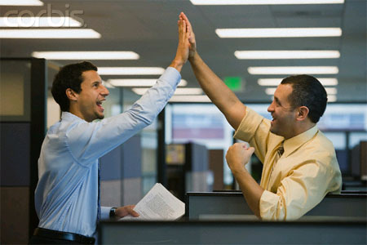
Workplace Happiness 3656962 3459159

Slide 3
Happiness
“Happiness consists in activity. It is a running stream, not a stagnant pool.”
John Mason Good
Achieving happiness is one of life’s major goals. Happiness is subjective, and extensive research has shown that engaging in particular activities can improve our happiness levels.

Slide 4
BioGill
After observing, interviewing and interacting with employees of BioGill in different departments, we have assessed which aspects of your employment contribute to your happiness. We have made recommendations to increase the overall happiness of employees, and have discovered a theme of happiness that we believe can be applied to BioGill.

Slide 5
Your Current Happiness
When asked which aspects of your job make you the happiest, the most common and prominent responses from employees were:
When you achieve goals
When you complete various tasks
When you overcome challenges
When you have good working relationships and interpersonal interactions
When there is variation amongst work related tasks
These are all factors that are consistent with happiness research. Lyubomirsky (2008) states that goal setting, productivity, and good relationships can increase your overall happiness.

Slide 6
Implications
We believe that the common thread amongst these self reported happiness contributors is productivity - Marketing director, Elizabeth Lette, stated, “I am motivated by the idea of making a positive difference in the business. I am happiest when I can help move a business forward and contribute.”
We want to recommend physical activity to you as a way of increasing your productivity, achieving your goals and, in turn, raising your overall happiness levels.

Slide 7
Your current unhappiness
When questioned about the biggest cause of unhappiness at work, the most common answers were:
Lack of communication – managing working relationships
Lack of activity – productivity
Stress and pressure
We believe that participating in higher levels of physical activity will address all of these issues by allowing you to feel self fulfilled, be more productive in the work place, and allowing avenue’s for team bonding and relationship building.

Slide 8
Physical Activity
As employees of BioGill are mainly white collar workers, when asked if your job allows enough time for you to exercise sufficiently, only three out of eight employees answered “yes”. Manufacturing manager, Glenn Dearing, stated, “At my last job, we played sports twice a week. It was great for bonding and people were willing to work harder and longer”. Glenn also shared that getting to know his fellow co-workers in a different setting made him feel happy.

Slide 9
Physical Activity Benefits
It is widely known that physical activity results in many benefits. The Australian Department of Health states that physical activity can reduce the risk of heart disease, stroke, developing high blood pressure and developing type 2 diabetes. Regular physical activity can also help achieve and sustain a healthy body weight, reduce the risk of colon cancer, and build and maintain bones, muscles and joints, among many other things.

Slide 10
Physical Activity and Happiness
One other benefit of physical activity is that it reduces feelings of stress, anxiety and depression. This suggests that when you engage in regular physical activity, it can benefit you both mentally and emotionally as well as physically. It appears as though BioGill employees are aware of this, as 7 out of 8 employees stated that engaging in physical activity does make you feel happier. Some of you went further as to say that physical exercise gives you more motivation, makes you feel more confident, reduces your stress levels and gives you a clearer mindset.

Slide 11
Physical Activity and Happiness
An article published by the Journal of Physical Education, Recreation & Dance (2003) outlined the results of a study conducted by the Leisure Tends Group. The survey polled 1000 Americans and found that those who reported that they were active in any outdoor activities were happier than those who did not participate in any outdoor activities – This is what we want to prove to you!

Slide 12
BioGill and Physical Activity
Through interviews and observations, we discovered not all employees prefer or benefit from working as a team, so we have suggested activities that can be carried out by BioGill employees individually OR as a team. We have comprised a pack for each employee to motivate and encourage all workers to participate in more physical activity in order to become more productive and overcome the perceived obstacles with regards to physical exercise – with the ultimate aim to increase happiness levels

Slide 13
Evidence for Introducing Physical Activity to BioGill
One of the easiest forms of physical activity is walking. It is recommended that the average person should take 10,000 steps per day. The average inactive person takes only 3,000 steps, and being aware of how many steps you take can help to improve the number of steps you are taking. A study conducted by Thomas and Williams (2006) found that wearing a pedometer increased 70% of participants level of activity.

Slide 14
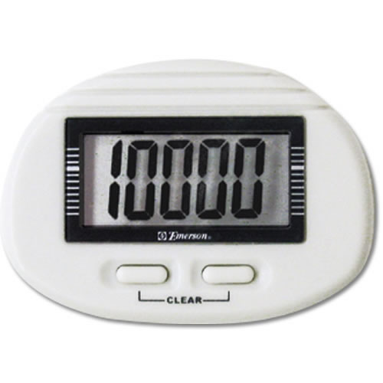
Pedometer
This is why we have included a pedometer on your individual packs. We suggest that you become more aware of how many steps you take and encourage you to walk even when you are working. For example, when you are reading through emails on your phone, or proof reading any business reports - This will increase productivity because 6 out of 8 of you said that your job does not allow you enough time to be able to regularly exercise, but if you multitask it will become possible
For those that enjoy turning these activities into a team activity we suggest that you get into two teams to see who can take the most steps within a week – This will increase team bonding, help to improve workplace relationships and also foster an environment for regular communication among employees

Slide 15
Evidence for Introducing Physical Activity at BioGill
7 out of 8 BioGill employees stated that they were not motivated to exercise at work because of either the lack of space and time or simply because it is not the norm and nobody does it or encourages it in the workplace
A study on physical activity in the workplace conducted by Bennie, Timperio, Dunstan, Crawford and Salmon (2010) found that those who indicated that their workplace provides facilities to support them being active had higher odds of being physically active at or around the workplace.
Loehr and Scwartz (2003) argue that full engagement in work requires drawing on four separate but related sources of energy: physical, emotional, mental and spiritual. Both individuals and organizations must not only have a sufficient quantity of energy, but also the right quality, focus and force of energy. Yoga and meditation are great examples of exercises that can be done to focus not only your body, but your mind as well

Slide 16
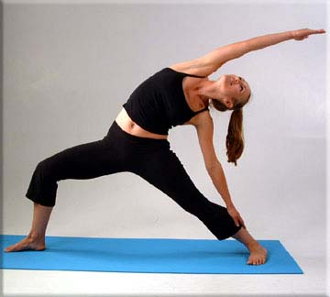
Yoga Application
Since you have all been provided with an iPhone as your work phones, we have provided you with an information flyer about how to download a free Yoga application called “Daily Yoga” – It allows you to have your own personal yoga instructor wherever you are!
There are different difficulty levels and different workouts you can pick ranging from a 20, 40 or 60 minute workout. These can be done outside during your 1 hour lunchbreaks individually or together. We observed that there are many secluded, grassy areas around the building that would be suitable

Slide 17
Evidence for Introducing Physical Activity at BioGill
In their book The Power of Engagement, Loehr and Scwartz (2003) argue that the key to working well is not managing time so much as energy, and that good mental and physical condition is essential for business success
They also states that business people should adopt several important energy management strategies including:
Taking ritualized work breaks every 90 to 120 minutes to decompress and renew energy. For example, take a walk or do deep breathing exercises. Life should be viewed as a series of sprints, not a marathon.
Moving the major muscles in your body about every 90 minutes to keep engagement at very high levels. Remember, movement engages you and lack of movement disengages you.

Slide 18
Skipping Rope
We observed that most of you were much less productive after your lunch breaks and especially between the hours of 2.00pm and 4.00pm – there was more non work-related office chat, less concentration and more of you getting up from your desks more frequently and using the bathroom, checking your phones or walking around the office
We suggest that you follow the advice of Loehr and Scwartz (2003) and every 90 minutes of the day you take a break, go outside and do 200 skips to redirect your energy and keep a high level of engagement in your work

Slide 19
Evidence for Introducing Physical Activity at BioGill
Among healthy older adults, resistance training has been associated with improved mood states. McLafferty (2004) and colleagues conducted a study examining the effects of a 24-week resistance training program with three weekly meetings. Following the program, participants reported significant improvements in total mood scores, as well as reductions in confusion, anger and tension
All of the above things were mentioned during interviews as reasons for making you unhappy at work, thus by improving your overall mood this will ensure that you will be able to manage relationships better and improve functional capacity

Slide 20
Free Fitness First Gym Pass
We have included in the pack a fitness first gym pass so that you can see do some resistance training with weights and professional machines. This pass also gives you access to specialised classes (e.g. spin, step, body pump) where you can learn exercises that can be practiced at home.

Slide 21
Evidence for Introducing Physical Activity at BioGill
Positive energy rituals are the key to making changes that last. Because we are creatures of habit, and will and self-discipline are severely limited resources, change is difficult. The key to building and sustaining behaviours that serve full engagement is creating positive energy rituals - highly precise behaviours that become automatic over time (Dalton, 2004)

Slide 22
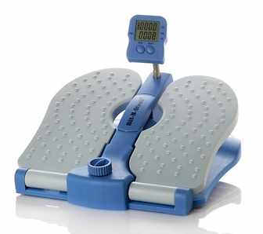
Floor Exerciser
By pedalling whilst at your desks, exercise can be incorporated into your everyday work as an automatic and habitual action

Slide 23
Drink Bottle
You must drink water all day, especially when exercising so that your body remains hydrated and you can function at full capacity

Slide 24
Conclusion
While exercise and work performance seemed unrelated to you at first, all of the mentioned studies have actually proven that physical activity can improve concentration and productivity and, in turn, overall happiness levels . People who exercise on a constant basis work better with their co-workers and have fewer medical and health-related expenses. There’s no better way to refresh your thoughts and clear your mind than by exercising. By taking time out of your day you really do work more effectively and more efficiently which will lead to a happier and more productive life ☺

Slide 25
References
Anonymous, 2003, “Physical Activity Boosts Happiness”, Journal of Physical Education, Recreation & Dance, Vol 74, Issue 8, pp17
Bennie, J., Timperio, A., Dunstan, D., Crawford, D., Salmon, J, 2010, “Environmental correlates of physical activity in Australian workplaces”, International Journal of Workplace Health Management, Vol 3, Issue 1, pp25-33
Dalton, P, 2004, “The Power of Full Engagement”, ABA Bankers News, Vol 12, Issue 16, pp1

Slide 26
References
Lyubomirsky, S., 2008, The how of happiness: a new approach to getting the life you want”, New York: Penguin.
Loehr, J, Scwartz, T, 2003, The Power of Full Engagement: managing energy, not time, is the key to high performance and positive renewal, Allen and Unwin Publishers.
McLafferty, C, Wetzstein, C, Hunter, G, 2004, “Resistance training is associated with improved mood in healthy older adults”, Perceptual and Motor Skills, Vol 94, Issue 3, pp 947–957
Thomas, L., Williams, M., “Promoting physical activity in the workplace: using pedometers to increase daily activity levels”, Intervention and Program Evaluation, Vol 17, Issue 2.

